Slide 1
Win-Win: Engaging Employers and Meeting Workforce Needs
Jessica Cinelli & Alissa Levine
Workforce Development @ Kingsborough Community College

Slide 2
Welcome!
Introductions

Slide 3
Continuing Education & Workforce Development
Established in 2007
Unemployed, underemployed, incumbent and opportunity youth
Entirely grant-funded by federal, state, local and private organizations
Industries: healthcare, technology, culinary/hospitality
Programs:
Consortiums: CUNY CareerPATH, Northeast Resiliency Consortium, Strengthening Community Colleges Comp TIA, CUNY TechWorks, CUNY Fatherhood Academy
KCC: DesignWorks, Job Corps Scholars, HealthPath, CarePath, Project Rise

Slide 4
We want to know about you!
POLL
Notes:
JESSIE
https://workforcecontedkcc.dashboard.vevox.com/#/meeting/248996/polls

Slide 5
How Has KCC OCE/WD Engaged Employers?
Tech Advisory Board
Engagement tools (T-Profile)
Employer Engagement Strategy (developed by KCC)

Slide 6
KCC’s Tech Advisory Board

Slide 7
How We Began
Purpose
Mission/Vision
Proposed members
Proposed facilitators
Proposed format

Slide 8
Purpose
Hear directly from employers about
Current and emerging job titles
Industry needs
Goals
Program/curriculum advisement
Activities and opportunities for students
Develop a pipeline of eligible candidates and increase employment opportunities
Assess the needs of Advisory Board members

Slide 9
Our Thought Process
Quarterly virtual meetings
Workforce Development and Continuing Education Focused
Employers connected to OUR programs
Employers help set agenda
Additional referrals and general feedback

Slide 10
How we did it – Finding the right members
Anchor Member
Employers in industries we were currently working in and industries we hadn’t yet entered

Slide 11
Dear (tech adv board partner)
Kingsborough Community College’s Division of Workforce Development, Continuing Education and Strategic Partnerships is forming a Tech Advisory Board and we would like to invite you to join. The Tech Advisory Board will provide Kingsborough with information from the field provided by content experts - like you - in order to help inform future credit and non-credit offerings at the college. Kingsborough strives to respond to the needs and gaps you will identify by designing programs that prepare New Yorkers to meet industry demands.
We understand that your time is valuable and plan to meet once quarterly for 90 minutes via Zoom. We welcome your input as we embark upon this endeavor in shaping the Board so that it is beneficial for Kingsborough and the Tech Advisory Board partners alike.
Our first meeting is scheduled for ______. Please let us know if you are interested in participating, and available to attend. Please let us know if you have any questions or suggestions. We appreciate you considering this request.
Sincerely,
Alissa Levine and Jessica Cinelli
Workforce Development
Kingsborough Community College

Slide 12
How we did it – Meeting preparation
Pre-meeting survey to get to know members
Provided overview of mission and purpose
Set expectations
Invited feedback and suggestions
Identified common day/time
Sent reminder with agenda ahead of meeting

Slide 13
How we do it - Logistics
Keep it small
Always have a notetaker
Have talking points and/or questions
Tailor agenda to allow employers to learn and contribute
Provide date/time of next meeting before concluding

Slide 14
Mutual Expectations
Advisory Board Members will:
Attend meetings
Contribute expertise
Be available for occasional outreach requesting advice
Allow KCC to publish your name as a member of the Advisory Council
In return, KCC promises to:
Stick to start and end on time
Support your efforts
Respect your time, and will not abuse your generosity

Slide 15
Tech Advisory Board Meeting
Agenda June 10, 2021
Introductions
Review Mission of Tech Advisory Board
The Board will support KCC in identifying emerging areas of technology that are sensible for KCC to pursue to develop new programs. The Board will provide feedback about industry and employer needs related to technical and 21st century skills that KCC will use to inform our approach to training and employment readiness services. Board members are encouraged to share their priorities and needs related to training and hiring, and identify areas in which KCC can support their professional efforts.
KCC Program Updates:
SCC, Design Works, UX Microcredentials, EDL Student Feedback
Round Table Discussion
● Expectations
● Participants
● Pathways into Tech
● Marketing and recruitment
● Program completion and entering employment
Employer Questions and Requests
Next Meeting: September 9, 2021 @ 11am
Thank you for joining us today! We appreciate your partnership.

Slide 16
Words from our board members:
2021 Survey

Slide 17
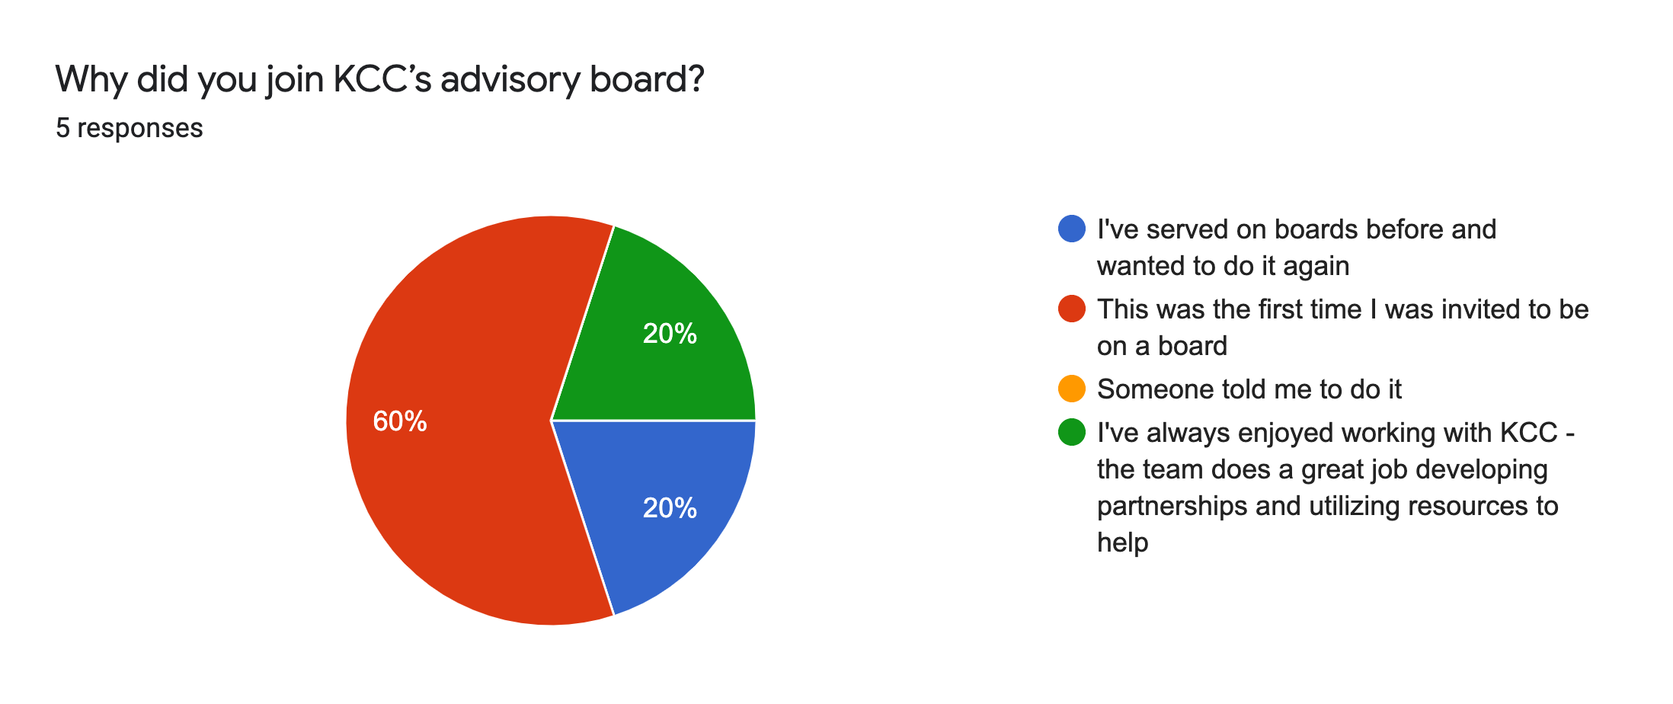

Slide 18
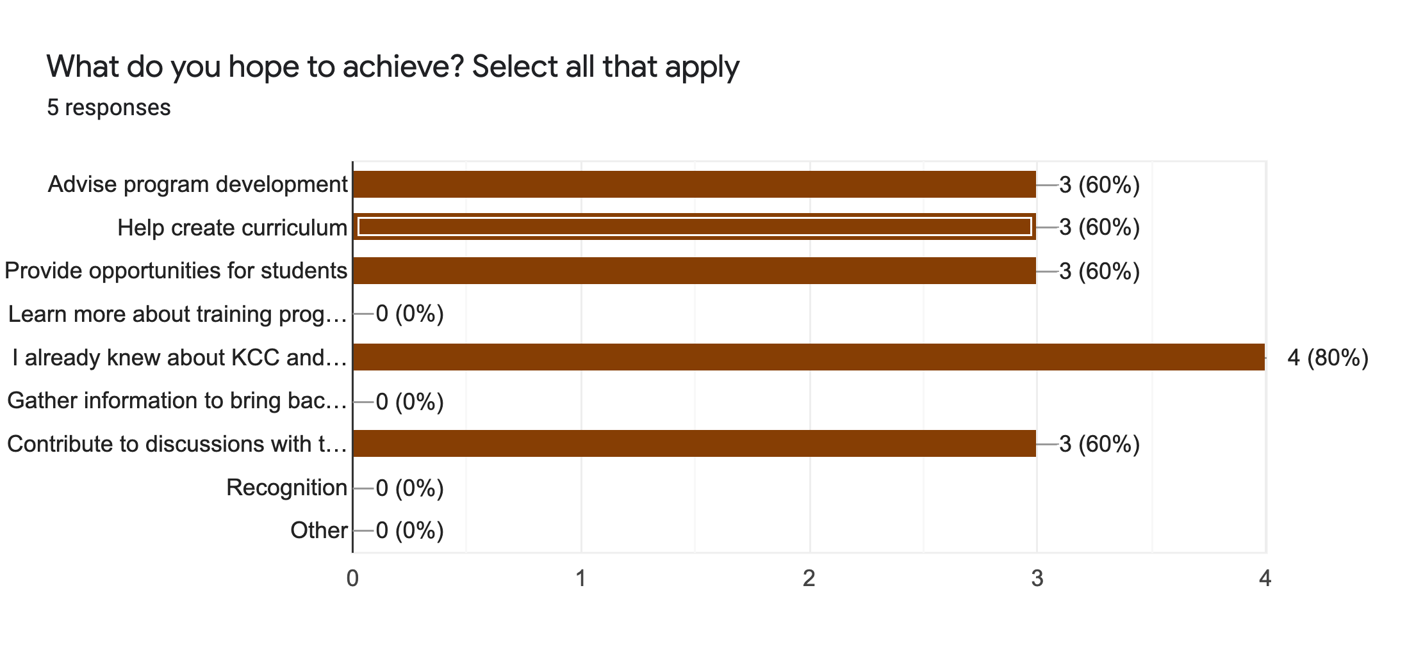

Slide 19
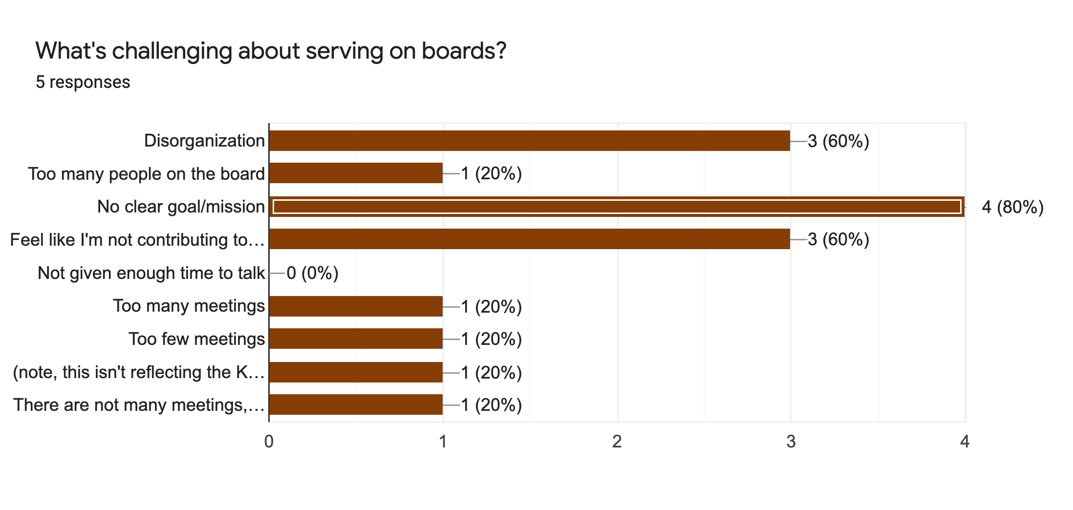

Slide 20
What has your experience been serving on other boards?
Pros:
Feels good to have positive impact using your own experience
Introduces you to new industries / businesses / programs
Good for networking & building relationships
Cons:
Can get time consuming depending on type of board
Many boards want you to donate money
Can feel like you're not accomplishing enough to make the time spent worthwhile

Slide 21
What is/was the best experience you’ve had while serving on a board?
It has been great to meet other like-minded people in my field and feel like I'm helping new generations of UX professionals get started.
It's already difficult to break into the field as it is so it feels good to know that I'm potentially helping folks from untapped communities share their perspectives and experiences with the UX community.
Diversifying the UX community is really important because it means that we will have technologies that support people from diverse backgrounds.
When it comes to CUNY boards - hearing from the students that work done has truly affected the way they approach their career.

Slide 22
Is there anything else you’d like to tell us?
Your board should be filled with donors and people with extensive experience running the finances and program building aspects instead of volunteers with hands-on UX or tech experience.
I think you should convert your board into volunteers to help with curriculum building and tactical goals. I'd like to spend my time helping the students directly instead of advising.
Pursuit (another board) is similar to KCC but geared toward developers/coders instead of UX designers. Very few if any of the board members have any actual experience as developers.
Maybe we should re-evaluate who is on the board with criteria that asks a certain commitment to the program?

Slide 23
Engagement Tools

Slide 24
T-Profile: Origin Story
Education Design Lab
National nonprofit that designs, tests and implements unique higher educational models and credentials that address the rapidly changing economy and emerging technology opportunities.
Community College Growth Engine Fund
The Fund selected 6 community colleges and systems that would explore leveraging innovation capacity, regional partnerships, and dynamic labor market data to identify and build sub-degree “micro-pathways” with designated credentials that employers validate. These 18 employer-validated micro-pathways designed to connect low-wage and entry-level workers to in-demand jobs that pay at-or-above median wage and put them on a path toward a degree.

Slide 25
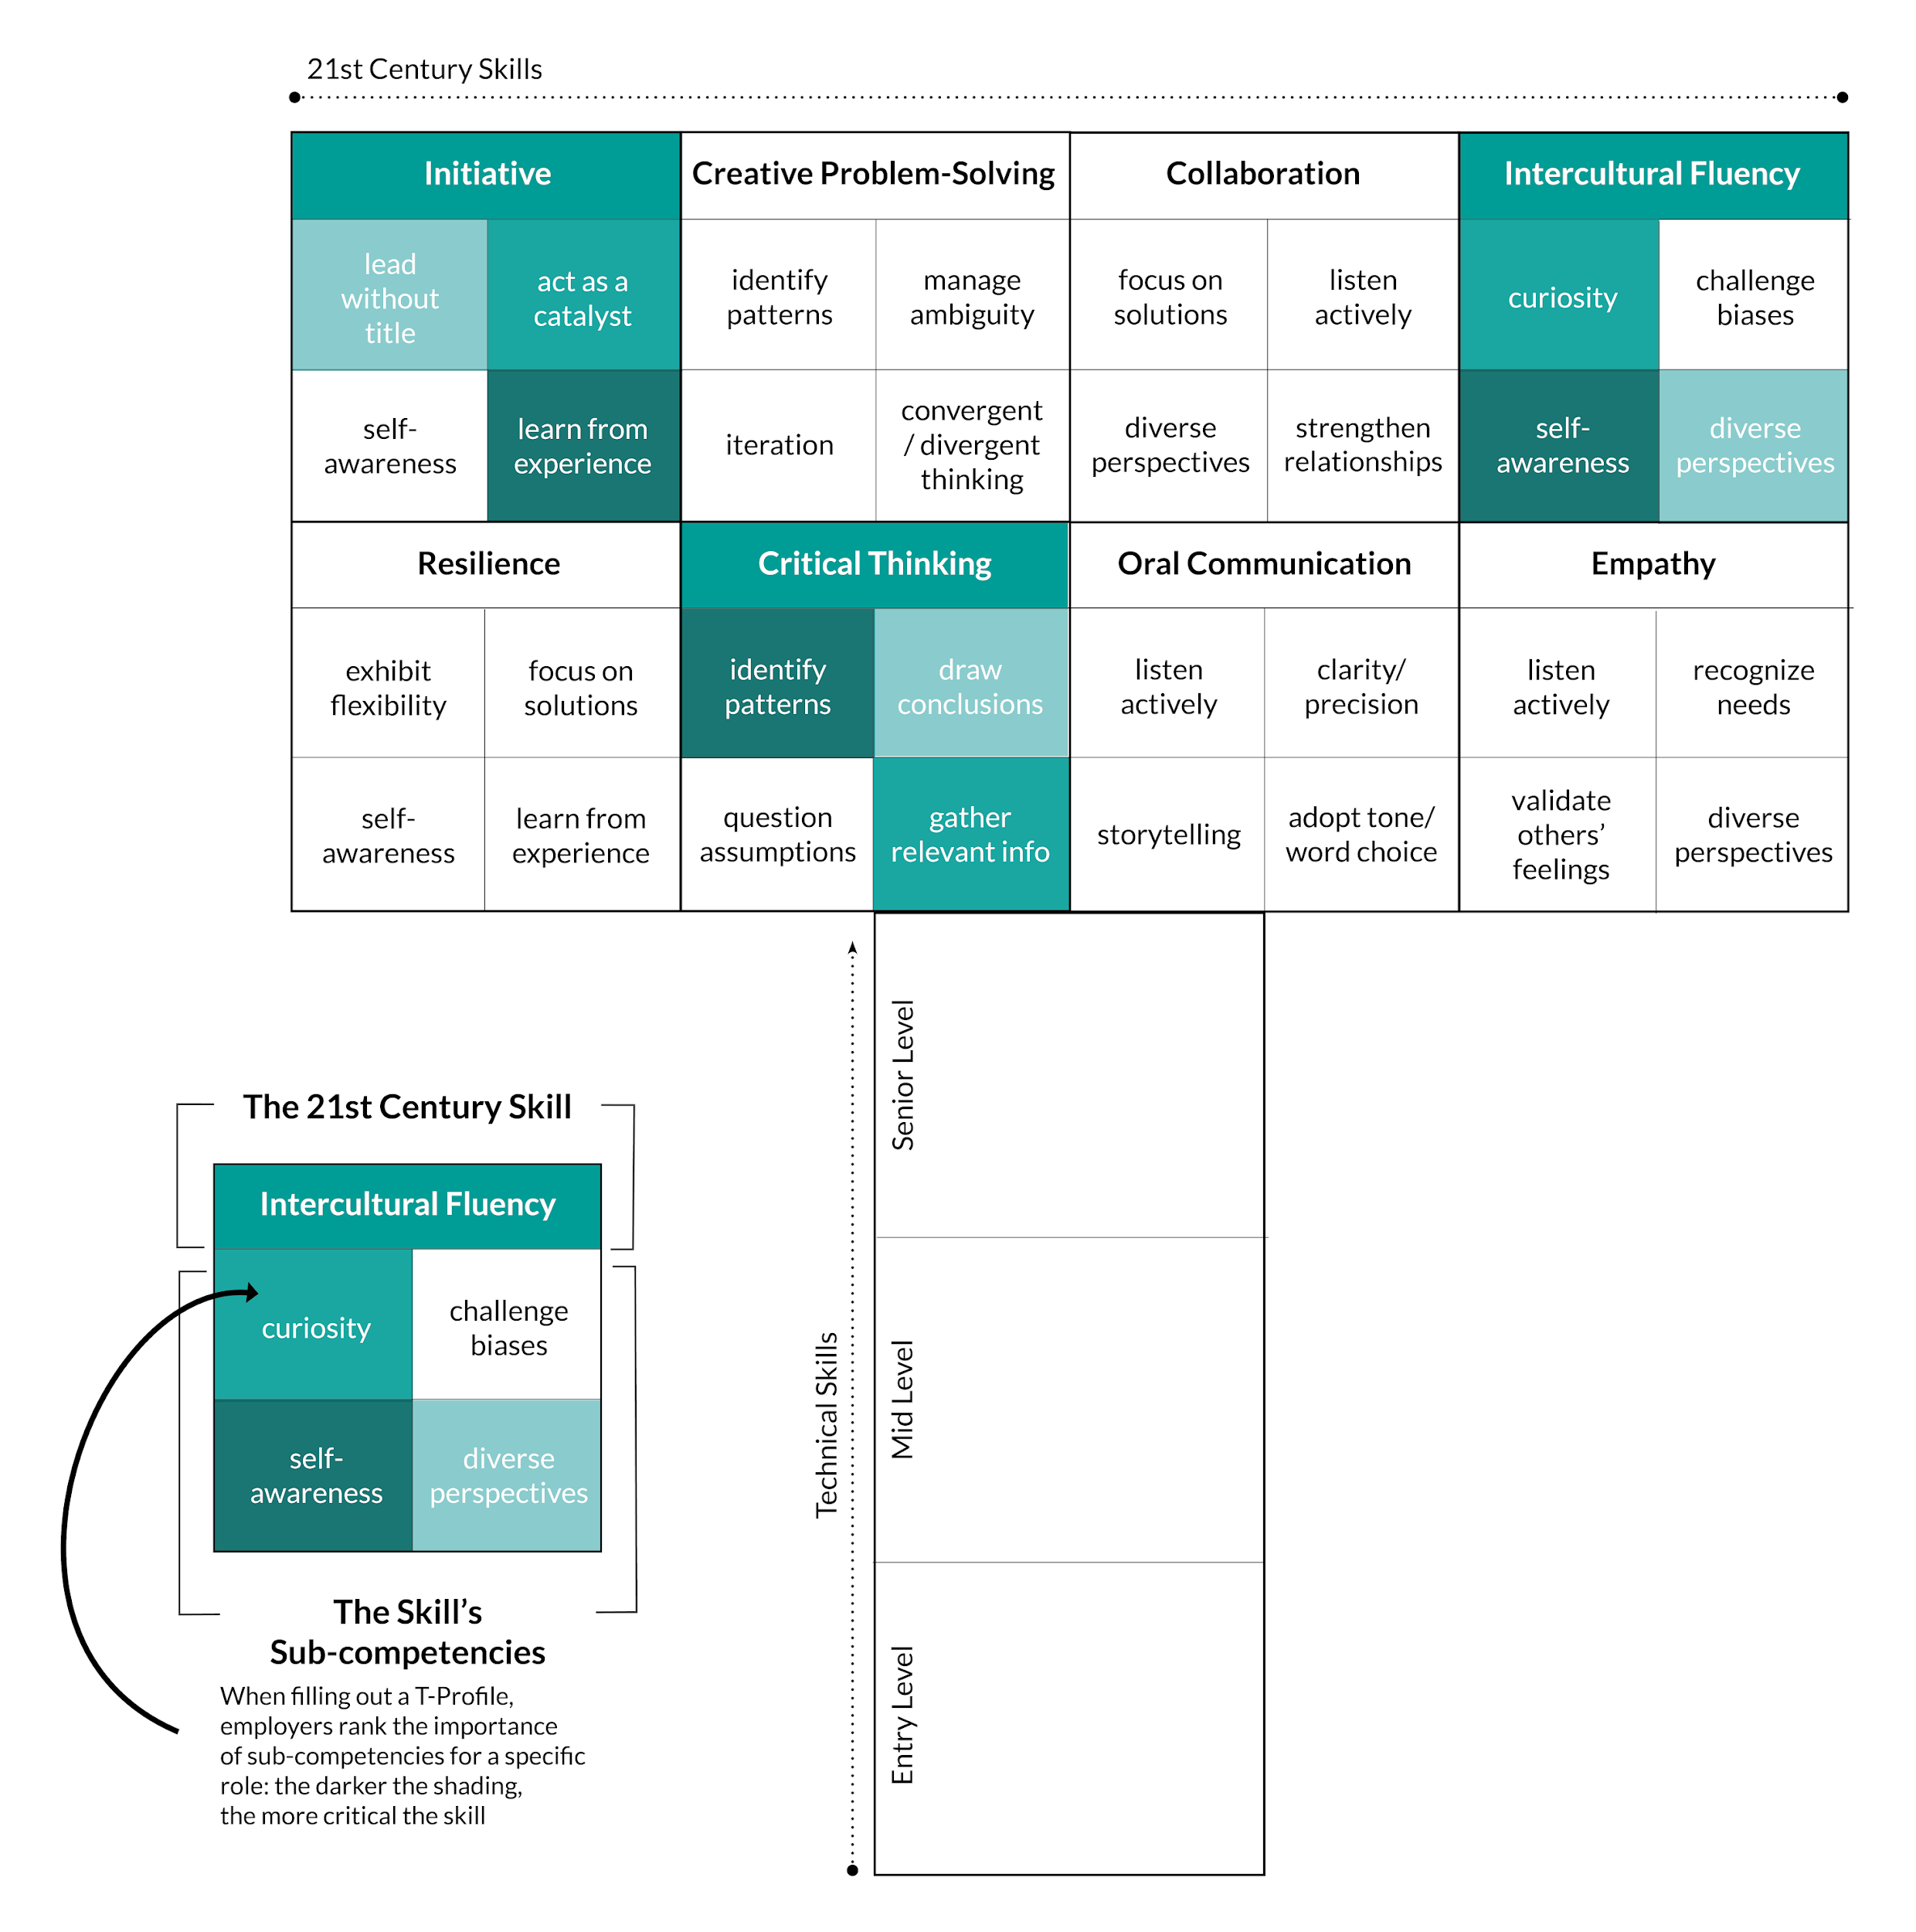
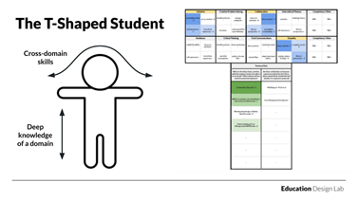
What is a T-Profile?
21st Century Skills
Technical Skills

Slide 26
Cross Domain Skills – 21st Century Skills

Slide 27
Unexpected outcome
Active interaction with a goal
Broke down beliefs
Connected the dots

Slide 28
KCC’s Employer Engagement Strategy

Slide 29
Employer Engagement Strategy (KCC CUNY TechWorks)
Learn the language of business and their needs.
Research the needs of local employers with respect to hiring needs and skills gaps.
Identify potential partners based on industry needs and standing employer relationships through existing programs, local workforce investment boards, Chambers of Commerce, economic development organizations, trade associations, and non- profits.

Slide 30
Reach out to champions in businesses where there potential for partnership
Engage individuals passionate about education with the corporate authority to commit company resources to the partnership.
Schedule an initial meeting with employers interested in pursuing a partnership. Bring preliminary research data, marketing material or industry analyses to the meeting to demonstrate our understanding of a commitment to addressing the hiring needs of the potential new business partners(s).
Create a single-point of contact to facilitate the creation and cultivation of partnerships between the business and us.
Ask employers to provide work-based learning experiences for participants (e.g. job shadowing, internships).

Slide 31
Invite feedback and other support as the program develops, and build long-term relationships with employers
Enlist employer partners to participate in the job placement process (e.g., conducting mock and actual interviews, hiring graduates, assisting with job placement at other businesses).
Ask employers to provide feedback about the success of program participants once they are hired.
Establish a program revision/evaluation schedule to ensure program content continues to be responsible to changes in the industry.

Slide 32
Maintain regular communications
Keep employer partners informed about the development of new curricula and programs design.
Promptly respond to correspondence from employer partners and follow through on action items agreed upon by the partnership.
Recognize employers for their input, support, and guidance as the program matures.
Develop a database of employee and community contacts.

Slide 33
Employer engagement - what has worked for you & what has not?
Lessons Learned
KCC: Hire a Separate Job Developer and Industry Liaison/Specialist
Writing out a new Employer Engagement Strategy for each program engages new and continuing staff
Best Practices

Slide 34
Thank you!
Jessica Cinelli: Jessica.Cinelli@kbcc.cuny.edu
Alissa Levine: Alissa.Levine@kbcc.cuny.edu

