Slide 1
Fostering a Culture of Learning and Growth for Adult Learners
Presented by Carol Meyer, Ph.D.
carol.meyer@ucawd.suny.edu

Slide 2
Introduction and Background
Who am I?
Why these practices?
Too often, we, as adult educators, rely on practices to support student success from K-12 schools or two- or four-year colleges. My argument is that adult learners need a unique combination of practices to support their success.

Slide 3
Our students have overcome many hurdles and challenges but they still have barriers.
Our students have grown up in complicated environments.
Our students may not have been successful in school.
Our students walk through our doors because they have hopes and dreams.

Slide 4
A Framework for Fostering a Culture of Learning & Growth for Adult Learners
Affirming Values
Signaling Safety
Neuroplasticity
Neuroplasticity
Support-ing
Goal Setting
Promoting a Growth Mindset
Neuroplasticity

Slide 5
I call them practices because they are
habits that need to be intentionally supported;
mindsets that need to be cultivated; and,
activities that exist on a developmental trajectory, we can always get better.

Slide 6
Neuroplasticity – What is it?
The Neuroplastic Brain
Plasticity and Learning
“Neuroplastic research has shown us that every sustained activity ever mapped – including physical activities, sensory activities, learning, thinking, and imagining – changes the brain as well as the mind” (Doidge, 2007, p. 288).
“It is important to understand that even the operations that control your learning ability and style are plastic” (Merzenich, 2013, p. 50).

Slide 7
Neuroplasticity – Why should we care?
We should care about neuroplasticity because it gives us a roadmap for how to support adult learners.
Science has taught us that we can…
Learn new things;
Learn how to learn;
Increase the speed of our learning; and,
Change both our cognition AND emotions.
Neurons that fire together, wire together (Hebb’s law, 1949 – Donald Hebb, psychologist)

Slide 8
Neuroplasticity – The good news and the bad news
“The plastic paradox is that the same neuroplastic properties that allow us to change our brains and produce more flexible behaviors can also allow us to produce more rigid ones” (Doidge, 2007, p. 242).
We tend to underestimate our potential to be flexible (p. 243)
At the same time, this plasticity leads to behaviors becoming more rigid, preventing other changes from occurring. (p. xx).

Slide 9
Neuroplasticity – Your mind is a muscle
“For people, postmortem examinations have shown that education increases the number of branches among neurons. An increased number of branches drives the neurons farther apart, leading to an increase in the volume and thickness of the brain. The idea that the brain is like a muscle that grows with exercise is not just a metaphor” (Doidge, 2007, p. 43).

Slide 10
Neuroplasticity – So what?
For adult learners we need to support the development of their capacities so that they have the:
emotional bandwidth to learn;
belief in themselves that they can learn; and,
tools to help them achieve their goals.

Slide 11
Practice #1 – Affirming Values
Self-affirmation exercises have been shown to lead to improved academic performance because:
“One’s larger sense of competence and worth are brought into view” (Steele, 2010, p. 176) making other identity-threatening cues less important.
“Better performance interrupts an otherwise negative process [of poor performance]” (ibid).

Slide 12
Shhhh. The trick is that students cannot know the purpose of the exercise for it to be effective.

Slide 13
Practice #2 – Signaling Safety
“Safety is critical in enabling humans to optimize their potentials along several domains. Safe states are a prerequisite not only for social behavior but also for accessing higher brain structures that enable humans to be creative and generative” (Porges, 2017, p. 47).

Slide 14
Signaling Safety– Danger versus Safety
The ACEs Study
Highlighted the impact of trauma
Launched a entirely new research agenda

Slide 15
So what happens when students get triggered?
Physical Processes: The Autonomic Nervous System
The response is involuntary
fight or flight and rest and digest
play dead (polyvagal theory)
Once the ANS is triggered, it has to be deactivated before the person has access to voluntary functions.

Slide 16
The Role of Self-Regulation - The Power of Breathing
“Breathing is one of the few body functions under both conscious and autonomic control” (van der Kolk, p. 64).
Breathing as a way of managing emotions:
“Because the respiration-emotion relationship is reciprocal, people may voluntarily influence their emotional state. By changing their respiration pattern. While emotions have such a reciprocal relationship with other bodily functions, respiration is special because it can be voluntarily altered” (Jerath & Beveridge, 2020, p. 3, emphasis added).

Slide 17
Signaling Safety: So what?
We know that trauma…
“reduces the capacity for problem solving, making meaning, identifying and expressing feelings, reading social cues, adapting to change, and consolidating memories. (Australian Childhood Foundation, p. 10).
Therefore, we have to
use what we know about neuroplasticity to mitigate the severity of present-day responses to past trauma.
create safe environments in which students are not triggered.

Slide 18
Consider on your own: Is there something more you think should be done to contribute to creating a safe environment at your workplace?

Slide 19
So, we need to create a safe environment in which our students can learn, but that is not enough.
Our students need to believe that they can learn.

Slide 20
Practice #3 – Promoting a Growth Mindset
“For twenty years, my research has shown that the view you adopt for yourself profoundly affects the way you lead your life… Believing that your qualities are carved in stone – the fixed mindset – creates an urgency to prove yourself over and over…This growth mindset is based on the belief that your basic qualities are things you can cultivate through your efforts” (Dweck, 2006, pp. 6-7)

Slide 21
Fixed Mindset versus Growth Mindset
Fixed Mindset (Entity Theory)
Intelligence and abilities are seen as fixed traits.
Poor outcomes are attributed to intelligence and therefore, out of the person’s control.
It is important to look smart.

Slide 22
Fixed Mindset versus Growth Mindset
Growth Mindset (Incremental Theory)
Intelligence and abilities can be developed
Poor outcomes are attributed to effort or strategy employed and therefore, within a person’s control.
Learning is more important that looking smart.

Slide 23
Fixed Mindset versus Growth Mindset
These mindsets are context (and discipline) specific.

Slide 24
Maintaining the Learning Mind Rather than Triggering the Evaluative Mind
The danger of good, bad, and favorites
The evaluative mind is expressed by the language we use and the tone of voice employed
Compliments can be problematic because they invoke the evaluative mind.
To learn, we need to see things as they are in relationship to where they should be.

Slide 25
So, we need to create a safe environment in which our students can learn and our students need to believe that they can learn, but that is not enough.
Our students need to experience success achieving their goals.

Slide 26
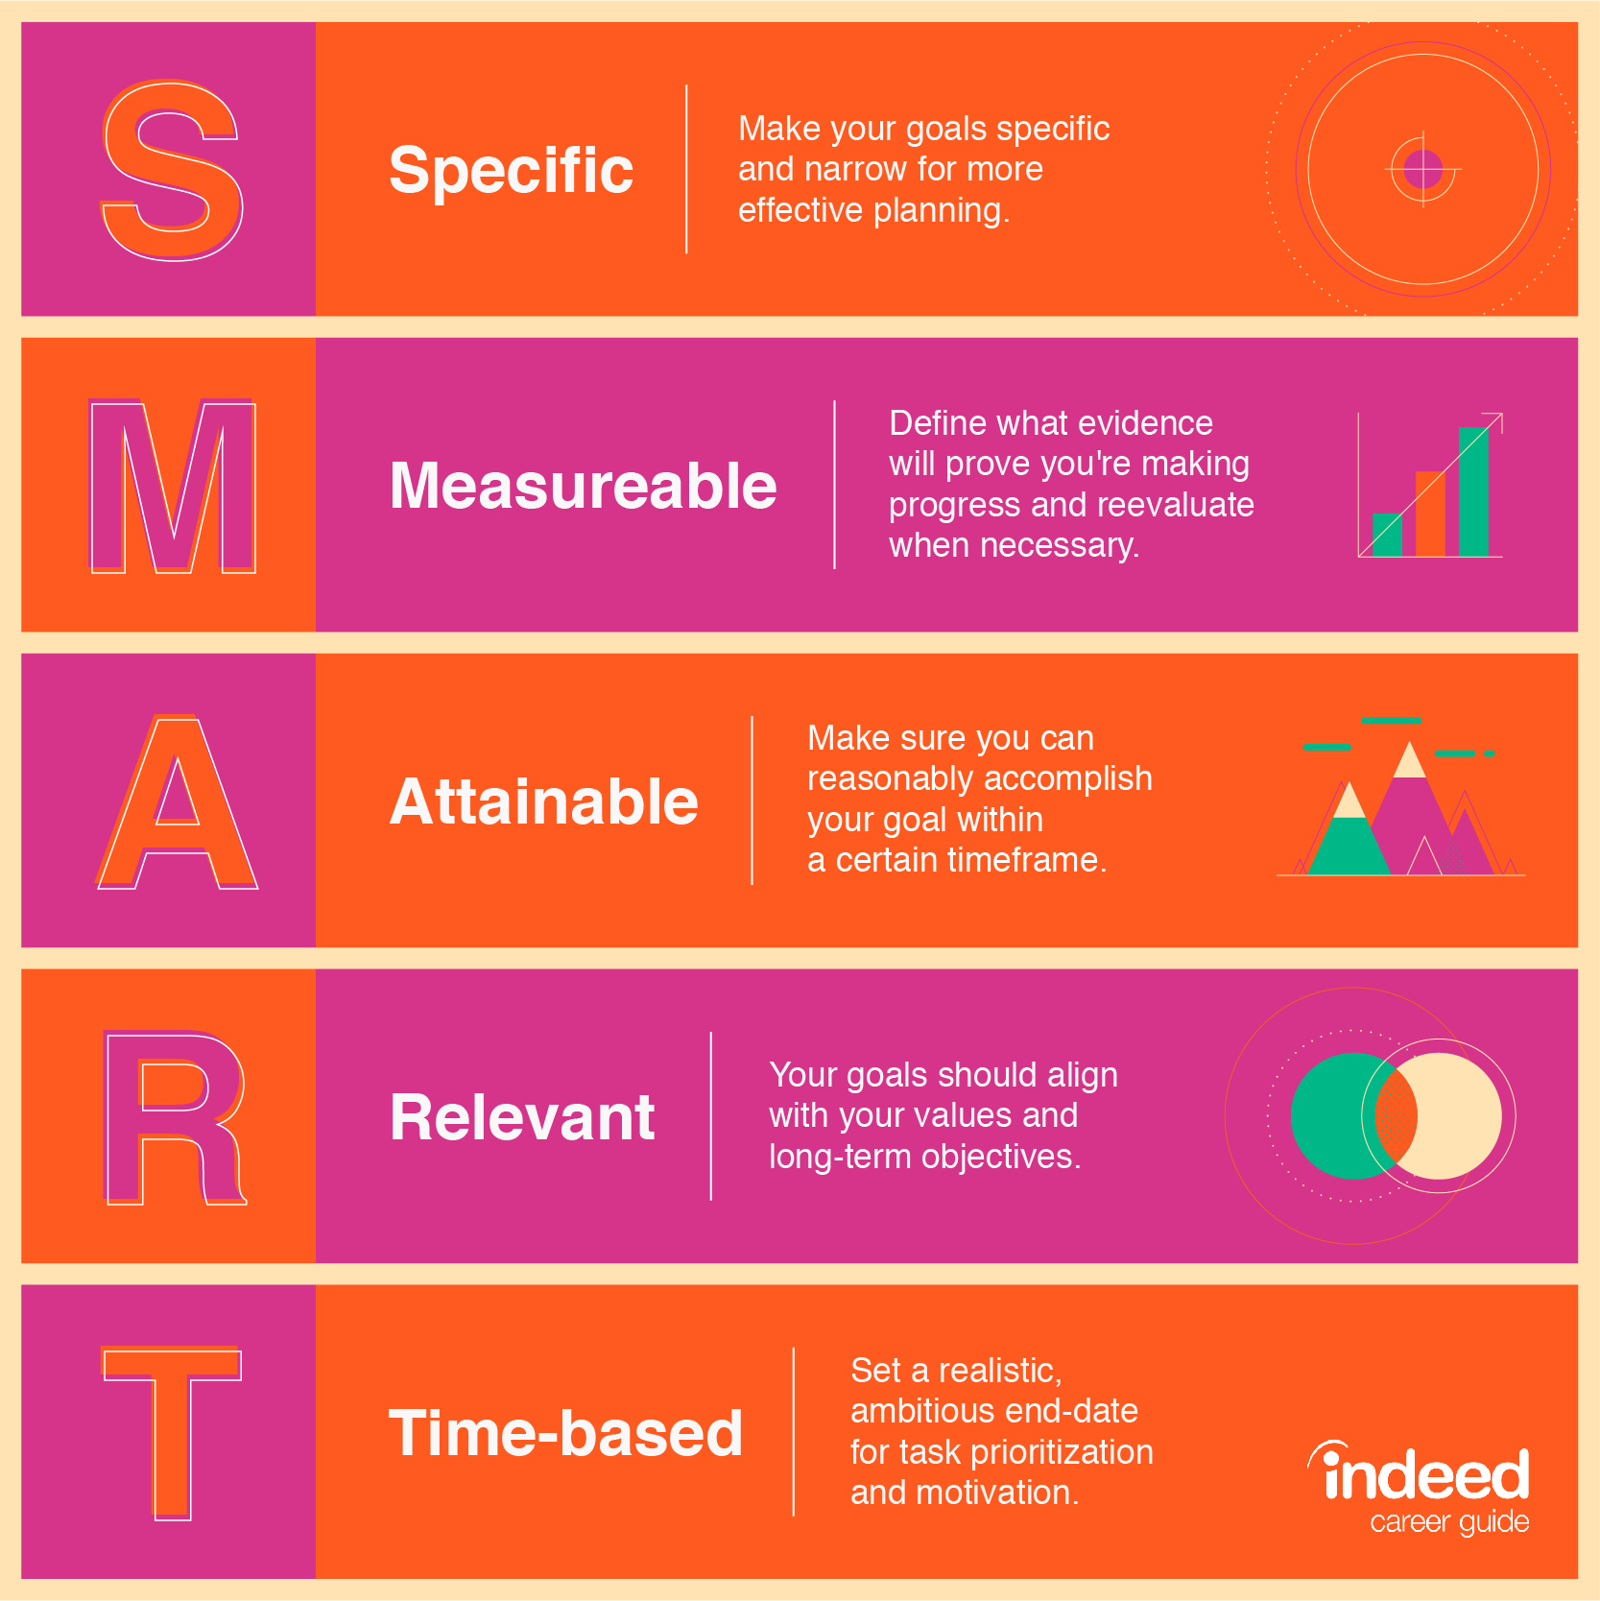
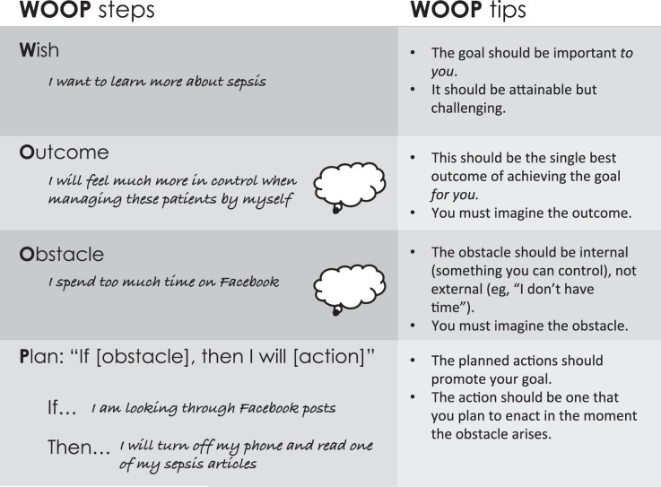
Practice #4 – Supporting Intentional Goal Setting

Slide 27
Why WOOP?
Need a tool to sustain motivation, which can be a challenge
Thinking positively is not enough
It is a tool that allows us to identify our internal barriers as well as external hurdles
“Mental contrasting”
is the process of dreaming and then immediately confronting realities.
identifies clear path of action to achieve goals.

Slide 28
Why WOOP? (continued)
We must first start with wish and then examine reality, the order matters
“When we think our wishes are feasible, the future and present reality become fused together on a nonconscious level; when they’re not feasible, the future and present reality don’t become fused but actually become disconnected” (Oettingen, 2014, p. 94).

Slide 29
Why WOOP? (continued)
By identifying obstacles, it brings into focus how feasible our goals are by providing an opportunity to identify goals that are achievable.
Achievable goals increase the likelihood of success.
One success leads to more success

Slide 30
Let’s practice.

Slide 31
A Framework for Fostering a Culture of Learning & Growth for Adult Learners
Affirming Values
Signaling Safety
Neuroplasticity
Neuroplasticity
Support-ing
Goal Setting
Promoting a Growth Mindset
Neuroplasticity

Slide 32
Final Thoughts
Trust in people’s ability to learn and grow.
Trust in people’s ability to re-wire their hearts and minds.
Trust yourself to do this work.

Slide 33
Wrap Up
Questions, thoughts, and/or comments

