Slide 1
The Labor Market, Technology & Politics … and it’s impact on New York November 8, 2017

Slide 2
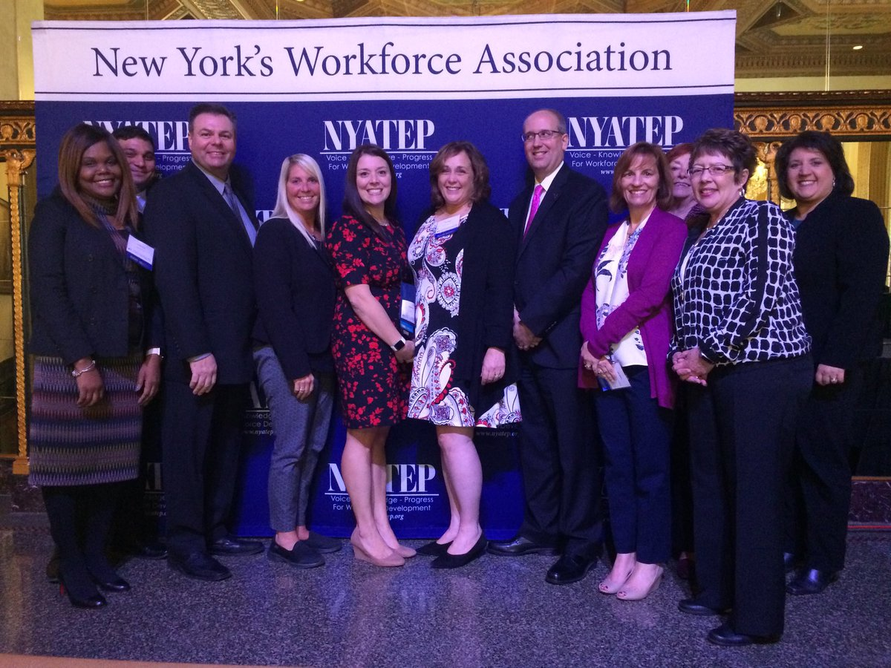
The New York Association of Training & Employment Professionals is New York’s workforce development association.
NYATEP and its member’s provides the leadership, vision and advocacy for a thriving workforce in New York State.
Our focus is ensuring that every New Yorker and employer in New York State has access to the skills they need to work in, and support a robust statewide economy.

Slide 3
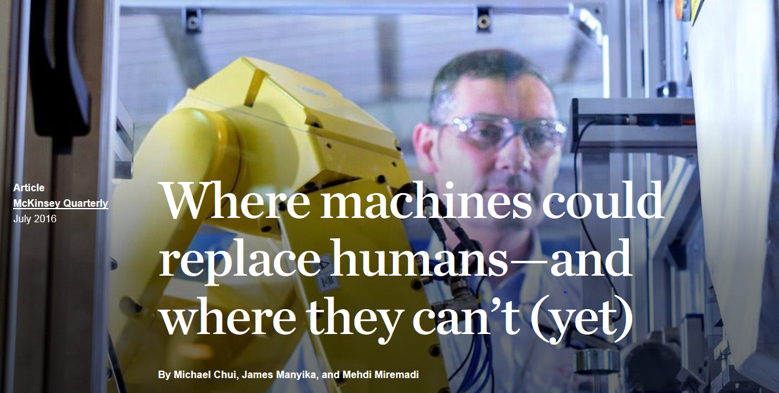

Slide 4
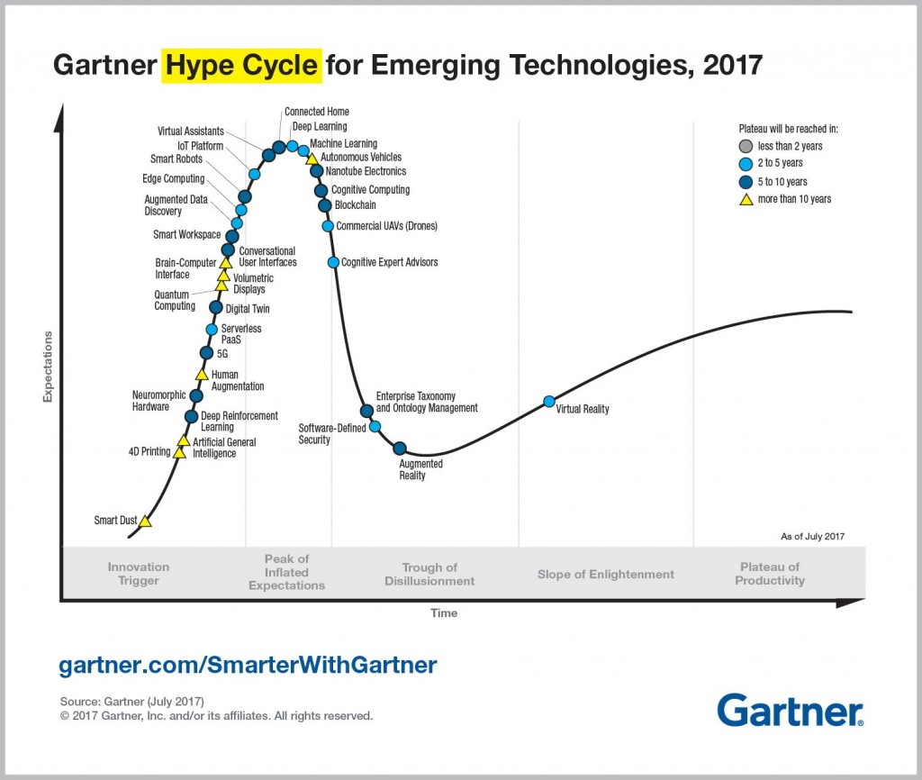
Notes:
https://www.accenture.com/t20170321T032506Z__w__/us-en/_acnmedia/Accenture/next-gen-4/tech-vision-2017/pdf/Accenture-TV17-Highlights.pdfla=en?la=en

Slide 5
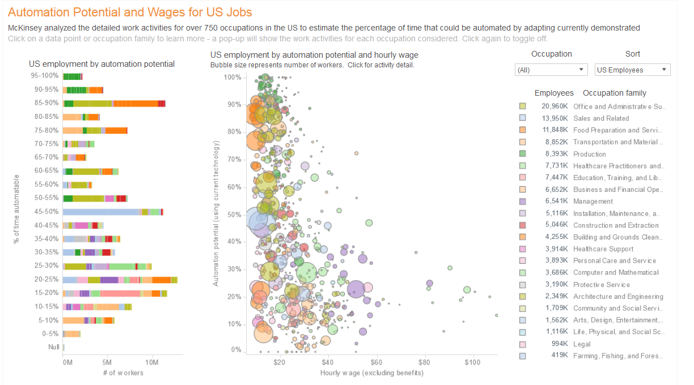

Slide 6
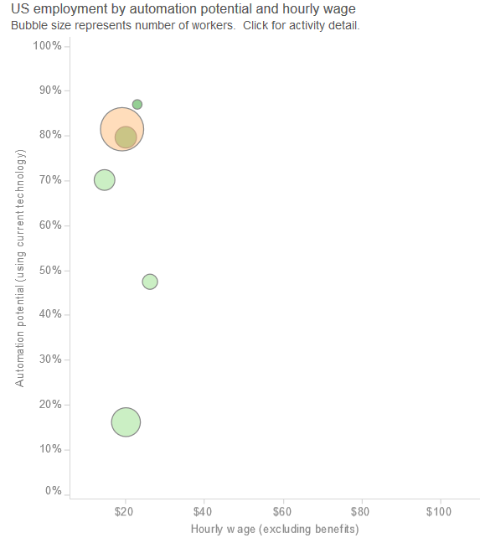
Tool and Die Makers – 87%
Heavy Tractor Trailer and Truck Drivers – 81%
Machinists – 81%
Pharmacy Technicians – 70%
Radiology Technicians – 47%
Licensed Practical Nursing – 16%

Slide 7
So, how will this impact jobs?
Conversational Interfaces
Virtual Reality
Driverless Cars
Automation
Internet Of Things
Shortage of data scientists and analysts driven by big data boom
https://public.tableau.com/profile/mckinsey.analytics#!/vizhome/AutomationBySector/WhereMachinesCanReplaceHumans
Notes:
https://www.mckinsey.com/global-themes/employment-and-growth/technology-jobs-and-the-future-of-work

Slide 8
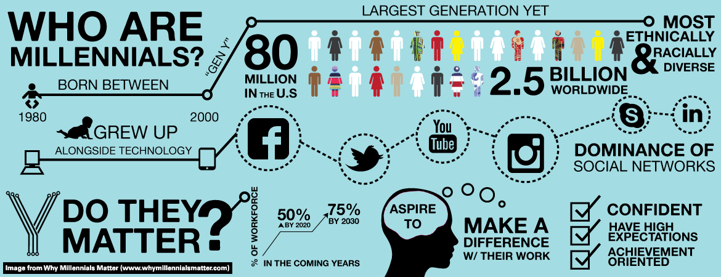
Now let’s talk about that generation that we just can’t seem to get to work…

Slide 9
Construction Workers Needed:
“Please do not apply if you oversleep, have court often, do not have a babysitter everyday, have to get rides to work later then our work day begins, experiences flat tires every week, have to hold on to a cell phone all day, or will become an expert at your job with no need to learn or take advice after the first day. Must be able to talk and work at the same time. Must also remember to come back to work after lunch. Should not expect to receive gold stars for being on time”

Slide 10
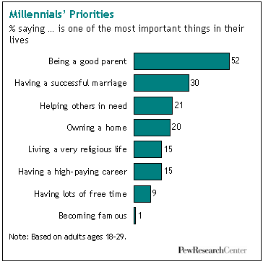
Engaging Millennials at Work
Want to connect to the “why”
They prefer a ‘flat’ work environment
Tech savvy
Task oriented NOT time oriented
Continuous learners
Want feedback (and recognition)
Want to enjoy what they do

Slide 11
Labor Market Trends
The State of the Workforce

Slide 12
Federal Context for Labor Market

Slide 13
Federal Context for the Labor Market
The number of long-term unemployed (those jobless for 27 weeks and over) had little change at 1.6 million in October (down 112,000). (Make up 25% of unemployed)
In the Underemployed and Marginally attached to the workforce categories:
4.8 million persons were employed part time for economic reasons (sometimes referred to as involuntary part-time workers) in Oct. (down 1,097,000 from a year ago).
1.5 million persons were marginally attached to the labor force in October (down 165,000 from a year ago). (The data are not seasonally adjusted.)
Among the marginally attached, there were 524,000 discouraged workers in October -- an increase of 37,000 from a year earlier.

Slide 14
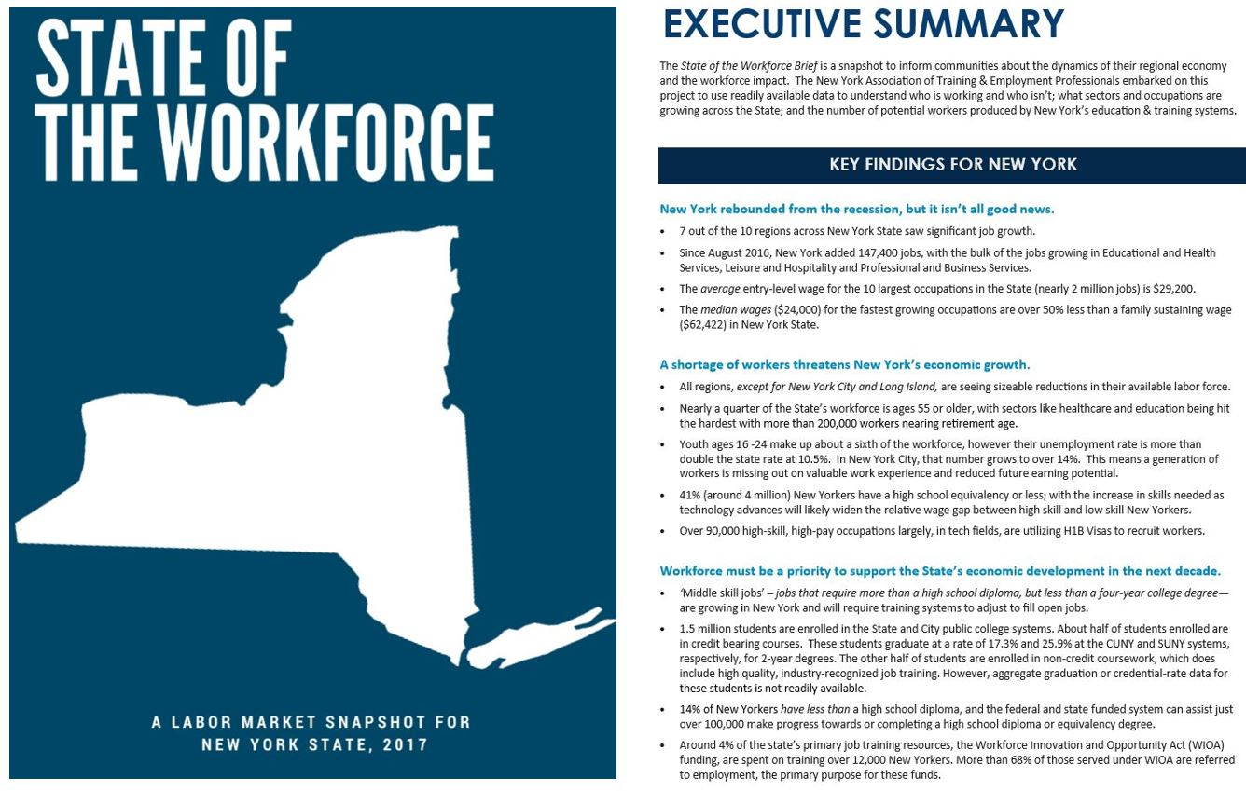

Slide 15
The good news: unemployment rate is down!
9,690,838 New Yorkers Over the Age of 16 Are In the Workforce
Includes marginally attached
Unemployed
562,069 People
5.8% Of Working
Age Adults
State reports 4.8%
Workers 16-54
7,049,325 People
78% Of Workers
$64,407 Avg. Annual Wage
Workers 55+
1,937,902 People
22% Of Workers
$73,294 Avg. Annual Wage
* As of 2016

Slide 16
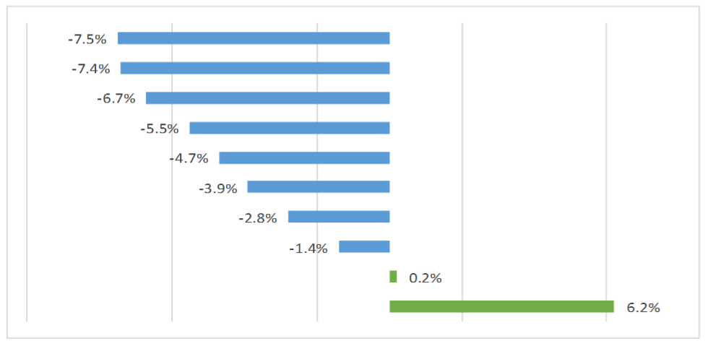
Bad news: We are facing a labor shortage!
REGIONAL CHANGES IN THE LABOR FORCE, 2010—2015
Southern Tier
North Country
Mohawk Valley
Central New York
Western New York
Finger Lakes
Capital Region
Hudson Valley
Long Island
New York City

Slide 17
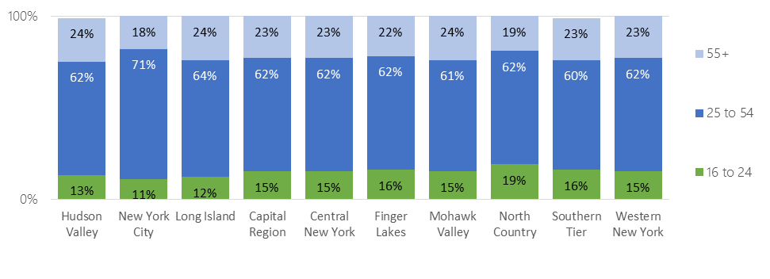
The workforce is changing…
REGIONAL LABOR FORCE PARTICIPATION BY AGE GROUP

Slide 18
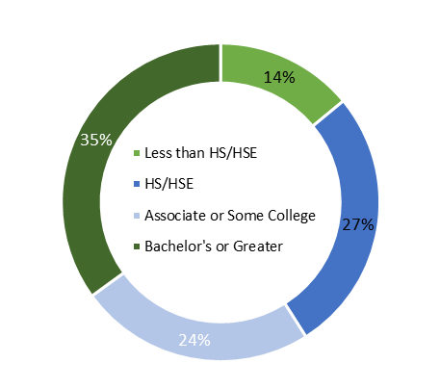
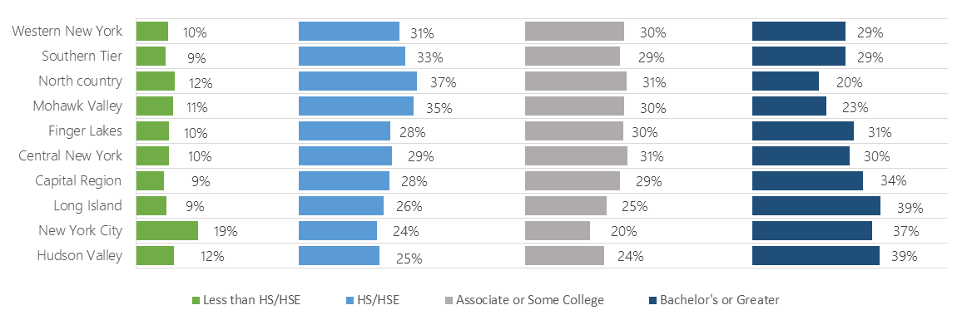
Education will play a key role in reginal competitiveness moving forward…
Statewide Educational Attainment
EDUCATIONAL ATTAINMENT BY REGION
Western New York
Southern Tier
North Country
Mohawk Valley
Finger Lakes
Central New York
Capital Region
Long Island
New York City
Hudson Valley

Slide 19
Statewide we have some work to do…
CUNY College Graduation Rates
2-Year Degree 5% 17.3%
(2012 cohort) (in 2 years) (in 3 years)
4-Year Degree 21% 48.4%
(2009 cohort) (in 4 years) (in 6 years)
Top Degrees:
Business
Liberal Arts
Health
SUNY College Graduation Rates
2-Year Degree 13% 25.9%
(2012 cohort) (in 2 years) (in 3 years)
4-Year Degree 50% 66.2%
(2009 Cohort) (in 4 years) (in 6 years)
Top Degrees:
Business
Humanities
Social Science
*NOTE: Graduation is reported at 150% of time to complete.

Slide 20
Training outside of the traditional pipeline
10 MOST COMMON WIOA-FUNDED TRAINING NATIONALLY July 2015—June 2016
Heavy and Tractor-Trailer Truck Drivers
Nursing Assistants
Registered Nurses
Licensed Practical and Licensed Vocational Nurses
Medical Assistants
Welders, Cutters, Solderers, and Brazers
Security Guards
Customer Service Representatives
Medical Records and Health Information Technicians
Computer User Support Specialists

Slide 21
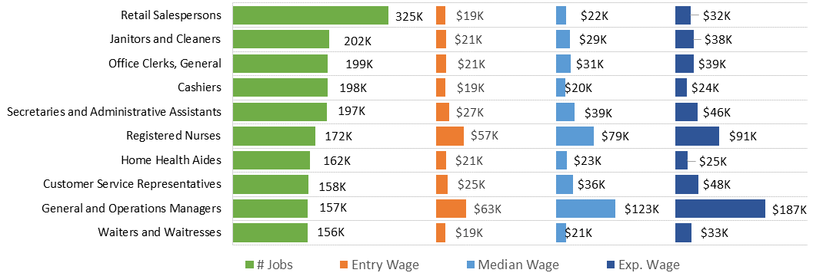
If we want to see the next generation economy…we need to attract higher skill jobs
10 LARGEST OCCUPATIONS STATEWIDE, 2016²⁷
Top 10 Occupation Expected to add the most jobs from 2014 to 2024

Slide 22
What we should we be doing now?
Engage
Engage young adults early and often; work experience
Invest
Invest in incumbent worker training and those with high school diplomas or less - - especially as the technology changes the landscape of work
Recognize
Recognize the changing ‘requirements’ of the workforce – workers are not just there to create profit (and retaining workers adds to the bottom-line)
Integrate
Integrate the economic development and workforce development systems

Slide 23
What is keeping me up at night?

Slide 25
This sums it all up…

Slide 26
NYATEP’s State Policy Priorities
Flexible, state funding that can address REGIONAL labor market needs; sector-based and career pathways models; and bring together a diverse network of partners. ($25 million per year)
Data – data – data & Infrastructure - Wage Data Clearinghouse ($500,000) and making the system tech-savvy
Invest in innovation – scale up practices that help us grow the system’s effectiveness (Apprenticeship; Work-based Learning (internships; IET) ($25 million per year)
Incumbent worker re-skilling – Expansion of Life Long Learning to include skill credentials and funds to retool existing workers as tech moves in ($5 million per year)

Slide 27
Update on the Federal FY 18 Budget Process
Congress has yet to agree to a budget resolution for this current fiscal year. It is an important process for moving tax reform (top legislative priority for Republicans right now) but there will need to be additional negotiation around federal government funding levels.
Republicans are seeking additional defense money (between $50-60 billion) and in exchange, Democrats are seeking additional funding for domestic programs.
Until an agreement is reached on those spending caps – not likely until mid-to-late November – FY2018 Appropriations will not move forward.

Slide 28
Federal FY 18 Appropriations
Funding for the federal government expires on December 8, 2017. (Operating at FY 17 levels until then).
Both the House and Senate Appropriations Committees approved FY2018 Labor, HHS spending bills – the House bill was ‘marked’ to an arbitrary level of $5 billion less than FY2017. That funding level led to Wagner-Peyser elimination in the House FY2018 Labor, HHS bill.
In terms of the process, the full House has approved its FY2018 Labor, HHS spending bill but there is zero expectation that it will become law.
The endgame on appropriations will depend on a broader budget agreement.
Notes:
Other Spending Debate Considerations
As if the funding conversation were not difficult enough, there are a number of other key political issues in play during these negotiations.
Healthcare – President Trump’s recent actions on healthcare – mainly ending the risk sharing subsidy payments – will put pressure on Congress to appropriate money for these funds. If left unfunded, the individual Obamacare market exchanges will be severely compromised.
Immigration – President Trump ended the DACA program that was created by President Obama giving Congress six months to find a legislative fix. The issue is obviously critical for both parties and will require a detailed compromise. The Democrats are starting with the ‘DREAM Act’ as their initial offer while President Trump is focused on securing funding for the Southern border wall as part of any deal. Right now there is a stalemate on this point
Debt Ceiling – The federal debt ceiling was extended as part of the deal that funded the government through December 8th. That is not a hard deadline on the debt ceiling but given it is a tough Republican vote, it may be an advantage to move it with a larger package.

Slide 29
Federal Administrative Actions
U.S. Department of Labor
Apprenticeship Task Force appointment.
The rules are likely to establish a ‘third party’ apprenticeship system primarily run by business – outside of the traditional DOL Registered Apprenticeship. The administration believes this will circumvent federal regulations that may hinder creation of some apprenticeships.
U.S. Department of Education
Executive Order on STEM and computer science funding which would increase federal grant funds by $200 million. The Department will need to create rules re-purposing existing programs to direct more money to STEM and computer science. Given the timing, we may not see those rules until early next year.

Slide 30
Other Federal tidbits
Federal approach is very “free market will fix it”
We are hearing rumblings that the Administration and USDOL would be open to WIOA waivers – with good data and a case for reducing administrative burden
Key influencers in D.C. are Governors and Business groups like the Business Roundtable and U.S. Chamber of Commerce
We are organizing quickly with our other State Associations – 17 in total – BUSINESS LETTERS ARE CRITICAL! Our biggest priority right now is protecting funding
Other items coming down the pike are: HEA, TANF and Perkins/CTE

Slide 31
What does this mean for workforce development?
Get ahead of the technology shifts
Become an advocate -- “we should be ‘best kept secrets”
DATA – DATA – DATA
Resistance to Change – be the field of ‘what if we’…

Slide 32
Melinda Mack, Executive Director
New York Association of Training and Employment Professionals
mmack@nyatep.org
518-433-1200

