Slide 1
The best center Genesee Community College
“We mean business”

Slide 2
The BEST Center
Business
Employee
Skills
Training

Slide 3
The BEST Center
Vision – To be the choice for business and individual skills training in the GLOW Region.
Mission – Provide quality training at a reasonable cost to improve business and individual skills’ performance in the GLOW Region.
We strive to create programs to best serve the business and organization needs of the GLOW region, identify our clients, support their needs and provide outstanding customer service.

Slide 4
What is The BEST Center?
Non-credit, Open-Enrollment Training Programs
- Certificate Training Programs
- Business Professional Development Classes
- CTLE Sponsor for Educators
- Online Training (Ed2Go, UGotClass)
- Driving Classes
• Business and Employee Skills Training
- Workforce Training Grants
- Contract Training

Slide 5
The BEST Center offers…
Customized training at our Batavia Campus, 6 Campus Centers or at your company/ organization.
Open-enrollment training courses
Flexible & convenient scheduling for training
Competitive and cost-effective pricing
Professional trainers and instructors
Training funding opportunities for companies and organizations
GCC facilities for hosting meetings

Slide 6
Chassix Automotive and The BEST Center Partner for an Innovative Mechanical Inspection Certificate Program
History of Chassix Automotive, Inc.
* Based in Batavia, NY
* Local Automotive Parts Manufacturer
* 175 Employees
* Currently one of the largest single company resource for high-quality, precision-chassis casting and machining solutions in the world

Slide 7
Identified a Training Need
Chassix Quality Manager and BEST Center Director of Business and Employee Skills Training
February 2016

Slide 8
Mechanical Inspection Certificate Program
Involved Eight Chassix employees:
All participants are employed in the Quality Assurance Department

Slide 9
Objective of Training
Enhance the Quality Inspectors Skills to include workplace competency and provide a more competitive workforce

Slide 10
Process of Training
Involved the following core competencies:
Technical Math
Basic Blue Print Reading
Advanced Blue Print Reading
Metrology
Geometrics

Slide 11
Curriculum Design
Training Hours = 120 Hours of Classroom and Lab Setting
Scheduled in the evening hours: 6:30pm – 10:30pm
Flexible hours for participants (Three shifts)

Slide 12
Trainers
Janet Schmidt – Adjunct Instructor
Brianne Berringer – Adjunct Instructor
Victor Kovach – Engineer
Annette Zuber – Technical Specialist and Adjunct Instructor

Slide 13
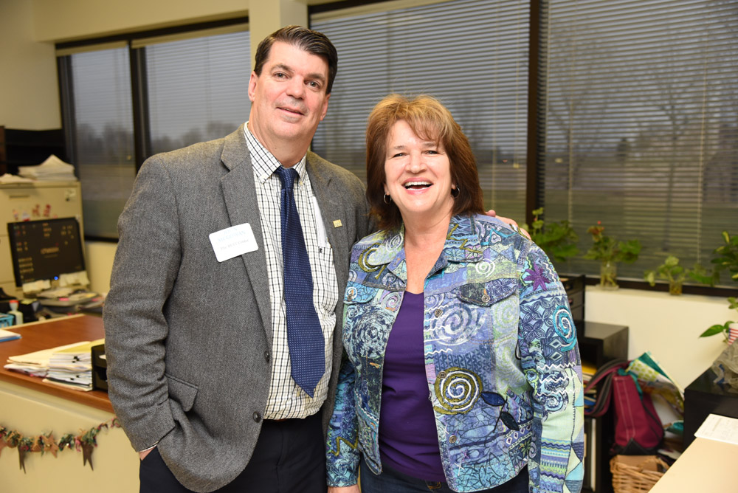
Non Credit to Credit EGR 117 Engineering Blue Print Reading
Janet Schmidt (Adjunct Instructor) and John McGowan (The BEST Center)

Slide 14
Advantages for Chassix Employees
* Classroom Lectures (Theory and Practical Applications)
* Hands on Learning into Lab Practicum
* Real Life Interaction with Instructors

Slide 15
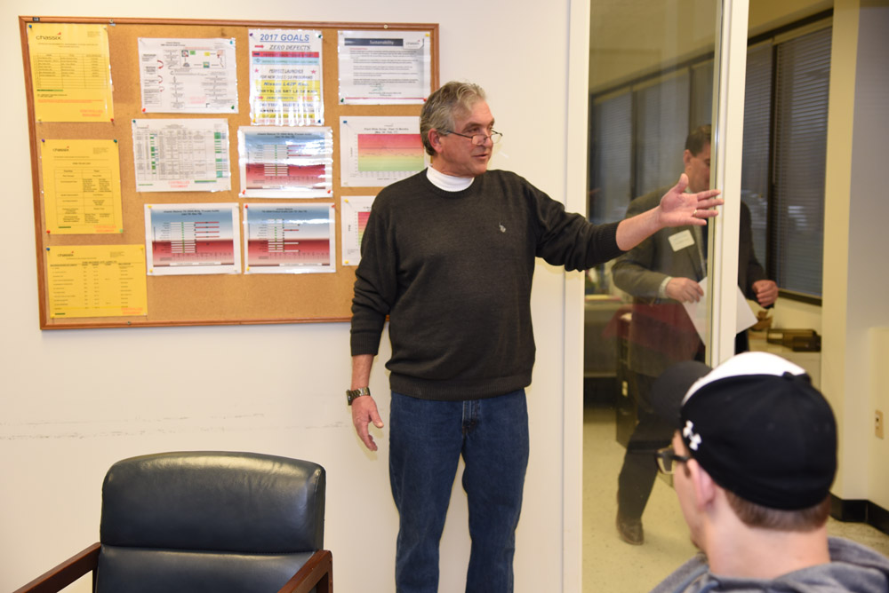
Chassix Quality Manager

Slide 16
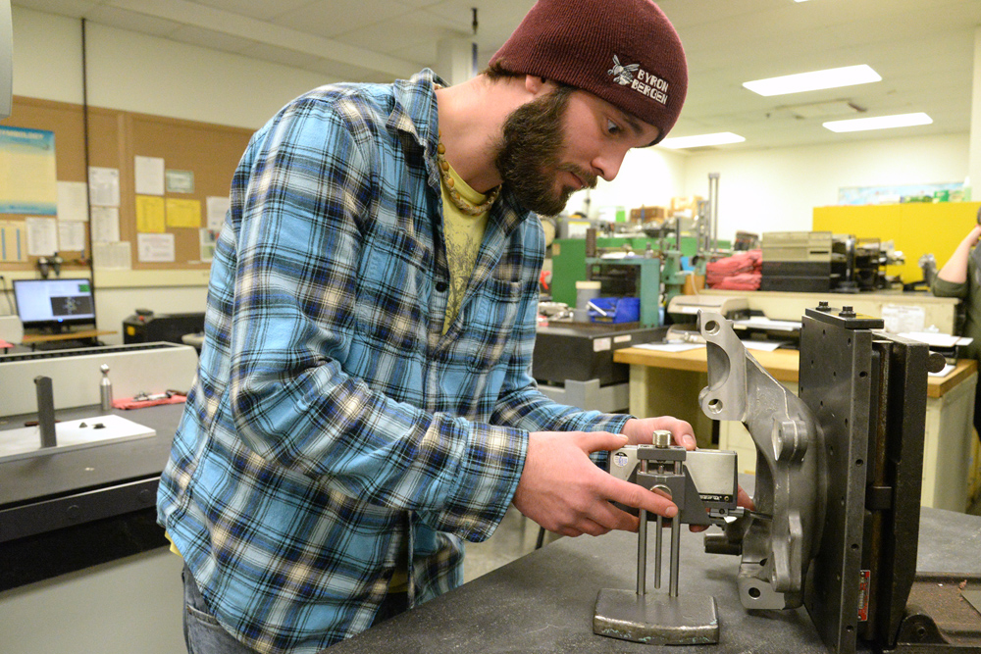
Chassix Quality Inspector
Practical Lab Learning with Metrology Measurement Tools

Slide 17
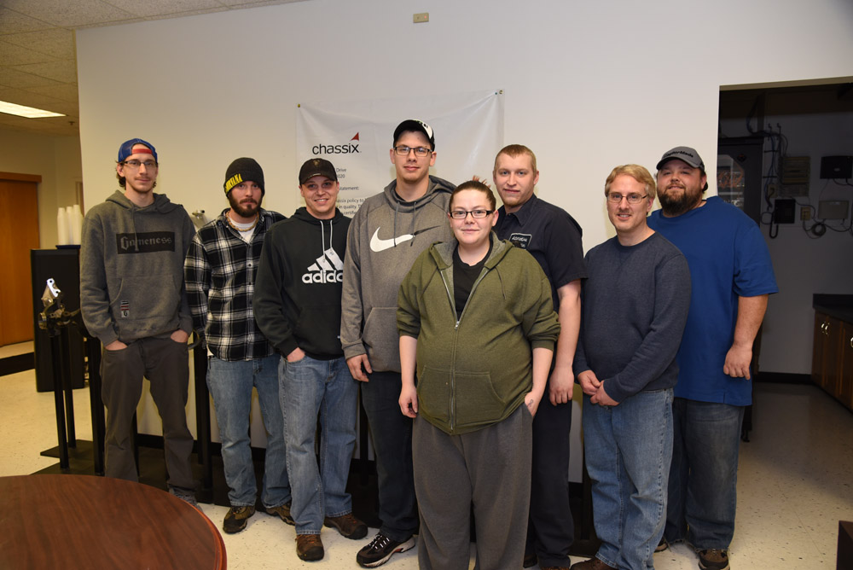
Graduation!
Certificates and Earning 3-Credit Hours of EGR117

Slide 18
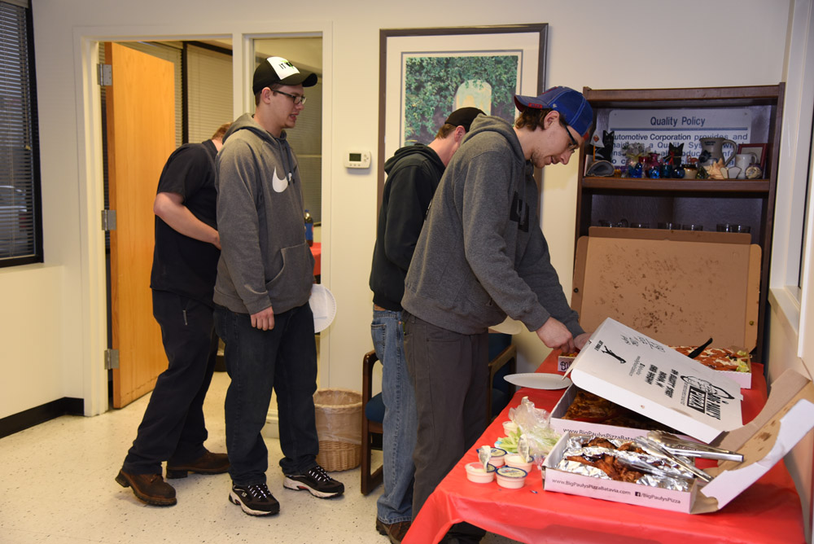
Pizza Time!!
Congratulations to All

Slide 19
Questions?
Reid Smalley, Executive Director
rjsmalley@genesee.edu
John McGowan, Director
jmmcgowan@genesee.edu
The BEST Center (585) 345-6868

