Slide 1

Emerging Apprenticeship Sectors in New York State
Franca Armstrong, Mohawk valley community college
Mary Kohan, SUNY SChenectady

Slide 2
Presentation in Three Parts:
I What is Registered Apprenticeship
II New and Emerging Sectors of Registered Apprenticeship
III Available Funding Sources

Slide 3
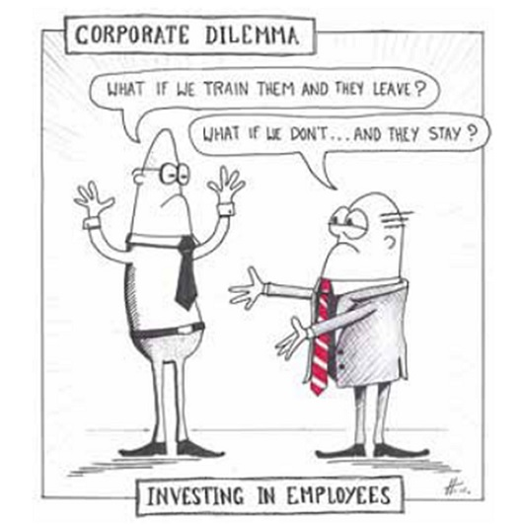
Let’s Start with Why?

Slide 4

Registered Apprenticeships IN NY (RA)
Real jobs
On-the-job training (OJT)
Related Instruction (RI)
Programs conducted by employers (sponsors)
Industry specific standard training outlines

Slide 5

Benefits for Apprentices
Full-time employees
High quality work
Wage progression
144 hours of RI per year
Skilled worker supervisor
Certificate of Completion

Slide 6

Business Benefits
Highly skilled workforce
Pipeline of qualified applicants
Efficiency and productivity
Workers trained without loss of production time

Slide 7

Business Benefits
Structured and consistent training program
Employee retention and attendance increased
Employer/employee relations improved
High-quality employment and
training opportunities

Slide 8

Registered Apprenticeship Expansion
New occupations and/or trades
New training approaches
  Time
  Competency
  Hybrid

Slide 9
Apprenticeship Programs in NYS
Model Examples:
Beachnut
NYPA
Revere
Schenectady ARC

Slide 10


SUNY Apprenticeship Program Focus Areas
Advanced Manufacturing Information Technology
Healthcare Other High Demand Industries

Slide 11


Slide 12
Healthcare
The tight labor market is particularly weighing on the health sector. The health-care industry added 368,000 jobs over the past year, while unemployment continues to hover near historic lows. There are simply more jobs than enough people to fill the positions nationwide.
We can viably create a pathway that makes it easier for people to enter the healthcare profession and be skilled up quickly while on the job.
According to the United States Bureau of Labor Statistics (BLS), the Healthcare Sector is projected to fill 5.6 million jobs by 2022, significantly more than any other sector of the country’s economy due in part to an aging population.

Slide 13
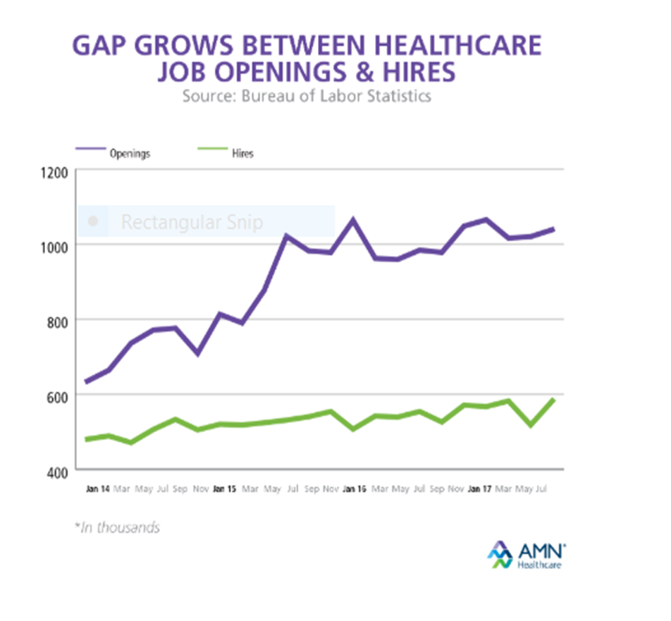
Healthcare
Source: Bureau of Labor Statistics

Slide 14
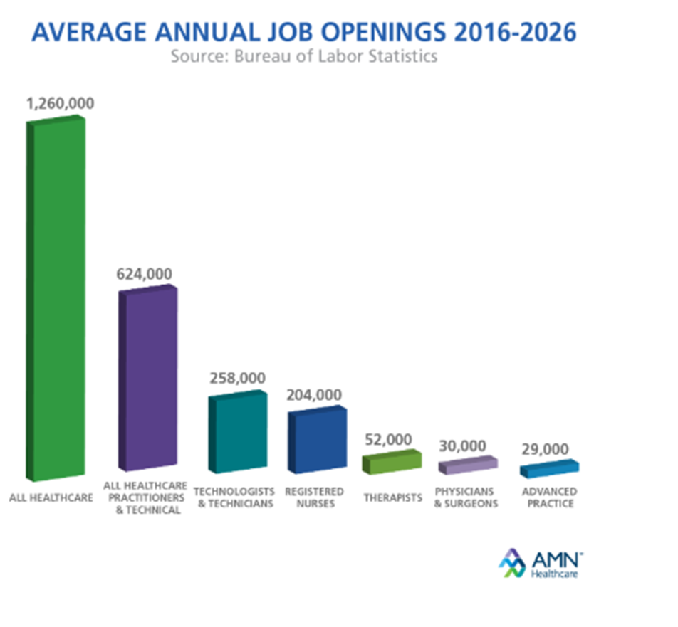
Healthcare
Source: Bureau of Labor Statistics

Slide 15
Healthcare
Community Health Worker At the USDOL Level:
Direct Support Professional -LPN
Medical (Hospital) Coder - Paramedic
Substance Abuse Counseling Aide - Medical Administrative Assistant
-and more!

Slide 16
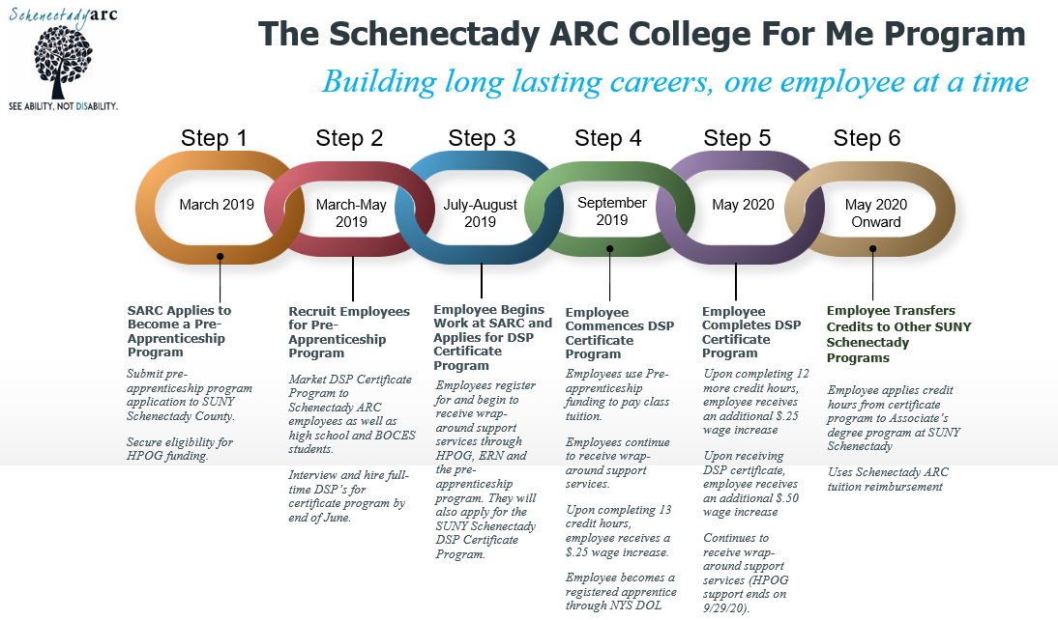
Healthcare
Source: Bureau of Labor Statistics

Slide 17
Information Technology

Slide 18
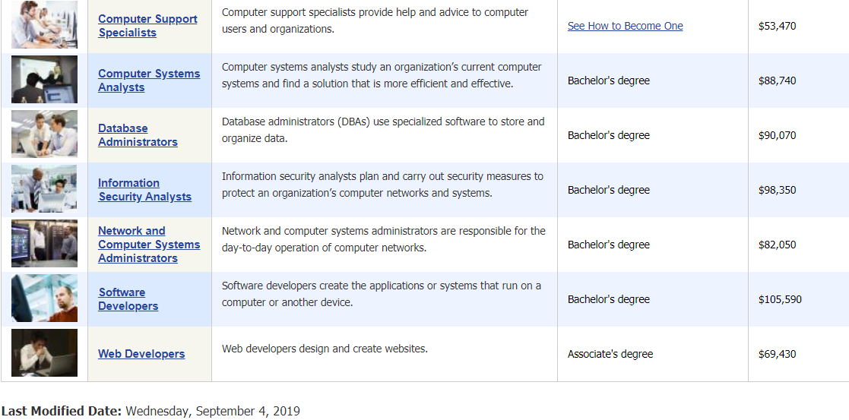
Information Technology
Source: Bureau of Labor Statistics

Slide 19

Funding Available

Slide 20
SUNY Apprenticeship Program Strategies For Funding
Related Instruction Training
Curriculum development
Industry Roundtables
Hybrid and competency-based programs and testing
Pre-apprenticeship

Slide 21
HOW TO APPLY:
What can your college apply for?
Funding Amounts
Industry Roundtables: | Up to $2,000 per roundtable
Related Instruction (RI) Costs: | Up to $5,000 per apprentice
Project Management (all projects are eligible | Up to 10% of total cost of projected project
Pre-Apprenticeship Program (per apprentice): | Up to $500 per pre-apprentice
https://www.mvcc.edu/apprenticeships/apprenticeship-app

Slide 22
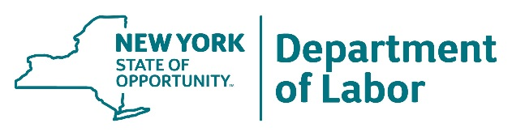
NYS Funding – Empire State Apprenticeship Tax Credit
NYS RA sponsors and signatories
Tax credit for apprentices employed full-time for at least
six months
Enhanced tax credits
  Disadvantaged youth
  Apprentices with a mentor
Focus on demand occupations

Slide 23
NYS Funding – Apprenticeship Expansion Grant
$4.2 million in total funding
Goal to expand RA
Apprentices enter high-demand occupations
Funding covers RA training costs of apprentices

Slide 24

Next Steps to Break into New Sectors
1) Leverage existing partnerships with employers in IT and Healthcare sectors.
2) Get creative with program approaches. What does your college have to support new programming on the credit or non-credit side in the above areas?
3) Don’t limit yourself to only the approved titles in NY.

Slide 25

Questions?
Franca Armstrong
Mary kohan (Healthcare)
Mohawk Valley Community College
farmstrong@mvcc.edu
Schenectady County Community College
kohanmj@sunysccc.edu

