Slide 1
CCI: The SUNY Vision of Access + Completion = Success
Presented by Carol Meyer, Ph.D.
Director of Academic Affairs
University Center for Academic and Workforce Development (UCAWD)

Slide 2
How many of you saw yourselves as college bound?
What were the forces in your life that made you see yourself that way?

Slide 3
Introduction
Meeting the Challenge of Supporting College Access
Challenges We Had to Overcome
Questions

Slide 4
The Challenge:
How to help academically- and economically- disadvantaged students see college as an attainable goal, particularly in a remote environment?
The Response:
Educational Opportunity Centers, ATTAIN Labs, and the College Connections Initiative worked together to help students and community members:
imagine what is possible,
access opportunities, and
trust that they can be academically successful and pursue post-secondary education.

Slide 5
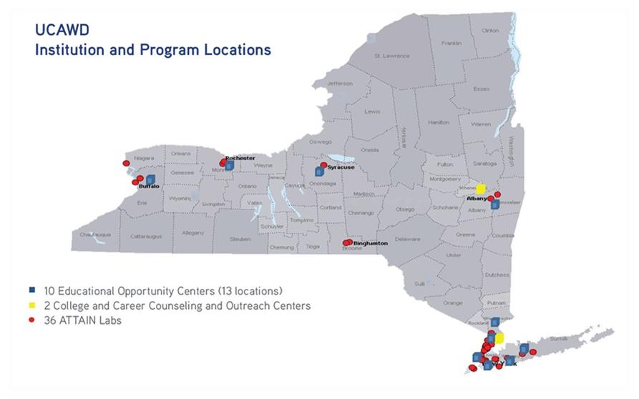

Slide 6
Imagining What is Possible
The College Connections Initiative Supports College Access by:
-having clearly established pathways to local colleges through Articulation Agreements
-leading college exploration – virtual and in-person tours of colleges

Slide 7
Knowing How to Access Opportunities
The College Connections Initiative provides:
-workshops on how to navigate the logistics of going to college
-one-on-one advisement and support for the college application process
-a physical location where students have access to computers and wifi

Slide 8
Trusting that It Can be Done: Building Capacities for Success
-academic support while enrolled in EOC academic programs
Three levels: Foundational, HSE Preparation, and College Preparation

Slide 9
-technology support through ATTAIN Labs (35 in the State)
-provide in-person and remote workshops that lead to Microsoft Office certifications
-academic and vocational courseware
-job search support, and
-a quiet place to work with internet access

Slide 10
-CCI Workshops
Skill development for success at college
Growth Mindset

Slide 12
-CCI Workshops (continued)
Skill development for success at college
Goal Setting
Time Management
Test Taking
Literacy development
Financial
Digital

Slide 13
Challenges We Experienced Doing this Work
-Barriers to communication with students
Changing phone numbers
Establishing relationships remotely – needed to wrap around our students
-To address these barriers, we had to increase communication between staff

Slide 14
-Having to orient students to the digital tools used for learning – in person and remotely
-Helping our students go from being able to use technology for their lives to becoming a digital problem solver

Slide 15
Final Thoughts
Questions or comments
Carol Meyer: carol.meyer@ucawd.suny.edu

